Slide 1

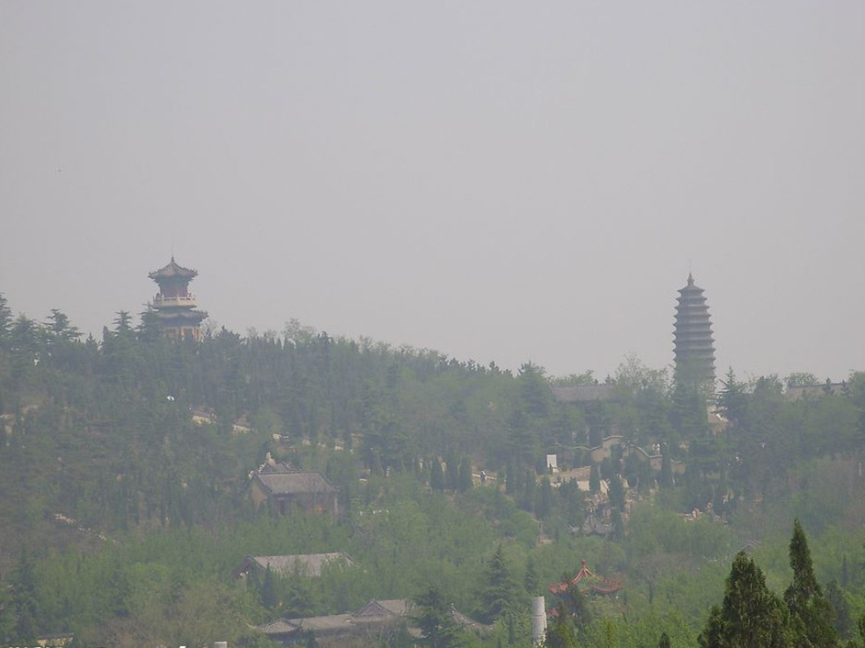
Single Image Haze Removal Using Dark Channel Prior
Paper author：Kaiming He
Jian Sunxx
Xiaoou Tang

Slide 2
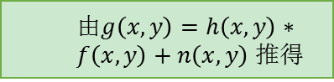
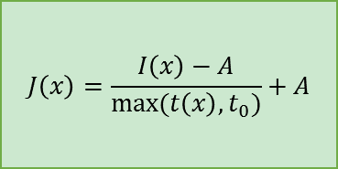
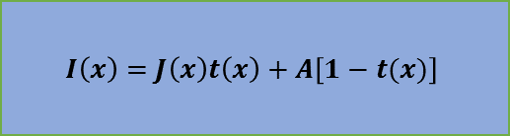
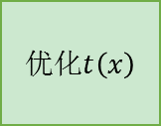
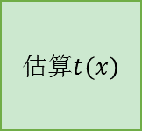

暗原色先验去雾流程图
怎么得来的？
怎么求$J\left(x\right)$？
由$g\left(x,y\right)=h\left(x,y\right)∗f\left(x,y\right)+n\left(x,y\right)$ 推得
$$I\left(x\right)=J\left(x\right)t\left(x\right)+A\left[1−t(x)\right]$$
估算$t\left(x\right)$
提出暗原色先验
求A
Soft matting 方法
优化$t\left(x\right)$
$$J\left(x\right)=\frac{I\left(x\right)−A}{max⁡(t\left(x\right),t_{0})}+A$$

Slide 3
content
The Standard Image Formation Model
Dark Channel Prior
Estimating the Transmission
Optimize Transmission Using Soft Matting
Estimating the Atmospheric Light
Recovering the Scene Radiance
Patch Size
Drawbacks

Slide 4
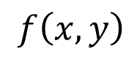
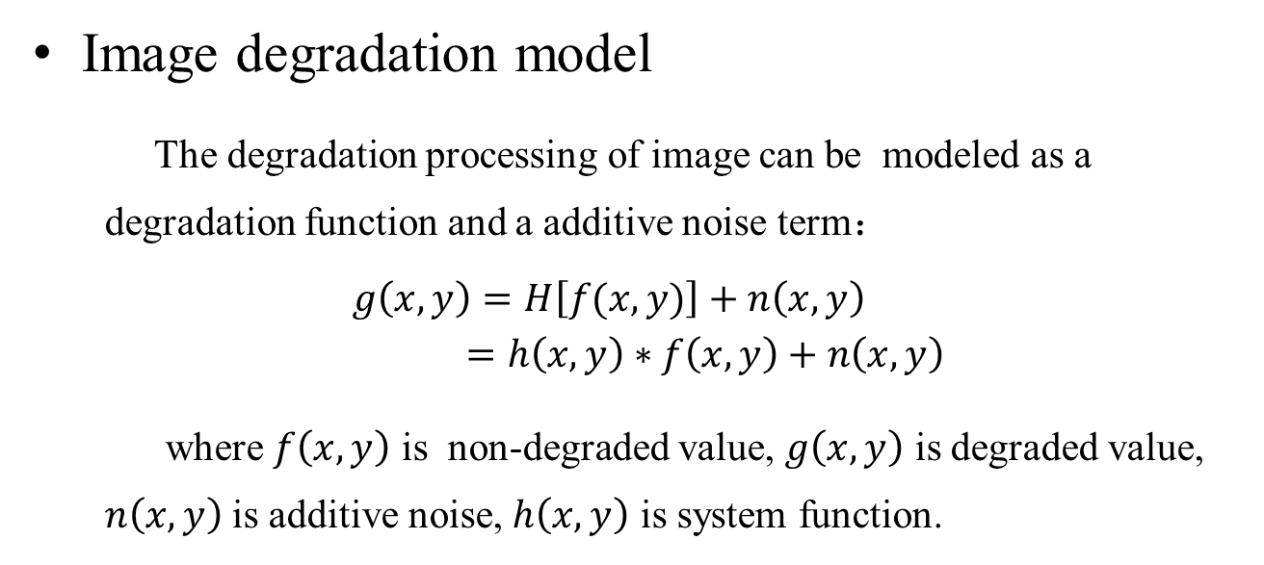
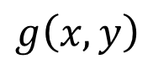
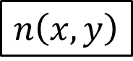
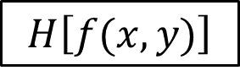
The Standard Image Formation Model
Image degradation model
The degradation processing of image can be modeled as a degradation function and a additive noise term：
$g\left(x,y\right)=H\left[f(x,y)\right]+n\left(x,y\right)$
$=h\left(x,y\right)∗f\left(x,y\right)+n\left(x,y\right)$
where $f\left(x,y\right)$ is non-degraded value, $g\left(x,y\right)$ is degraded value, $n\left(x,y\right)$ is additive noise, $h\left(x,y\right)$ is system function.
$$n\left(x,y\right)$$
$$f\left(x,y\right)$$
$$H\left[f(x,y)\right]$$
+
$$g\left(x,y\right)$$

Slide 5
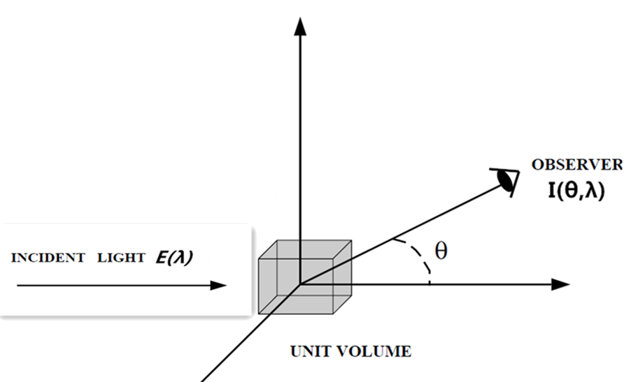
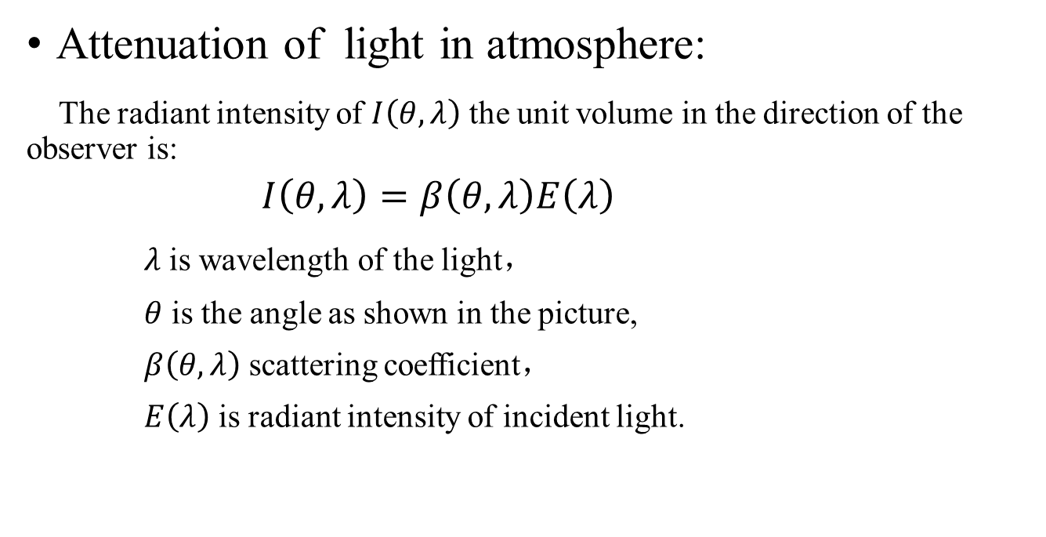
Quoted from Shree K. Nayar and Srinivasa G. Narasimhan “Vision in Bad Weather”
Attenuation of light in atmosphere:
The radiant intensity of $I\left(θ,λ\right)$ the unit volume in the direction of the observer is:
$I\left(θ,λ\right)=β\left(θ,λ\right)E\left(λ\right)$
$λ$ is wavelength of the light，
$θ$ is the angle as shown in the picture,
$β\left(θ,λ\right)$ scattering coefficient，
$E\left(λ\right)$ is radiant intensity of incident light.

Slide 6
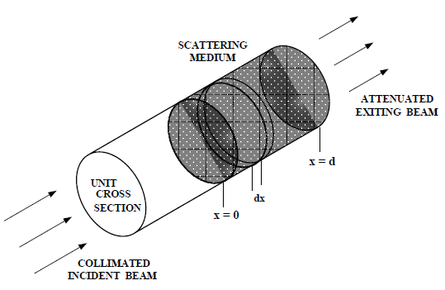
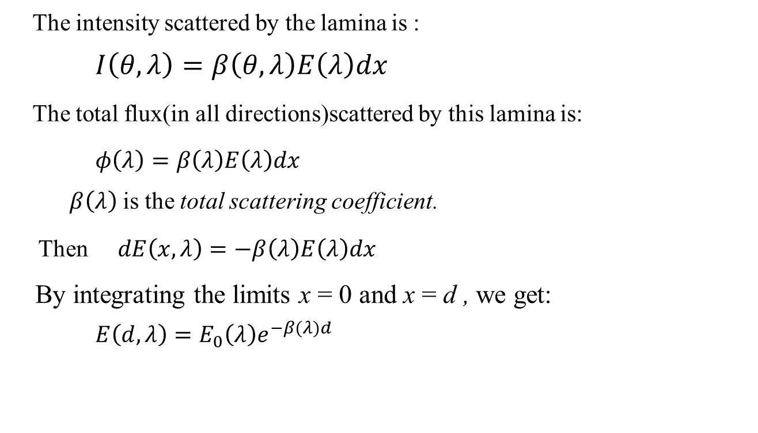
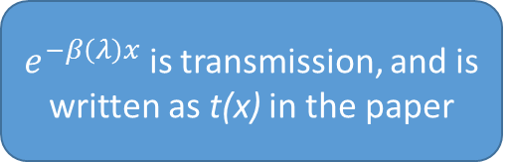
The intensity scattered by the lamina is :
$I\left(θ,λ\right)=β\left(θ,λ\right)E\left(λ\right)dx$
The total flux(in all directions)scattered by this lamina is:
$φ\left(λ\right)=β\left(λ\right)E\left(λ\right)dx$
$β\left(λ\right)$ is the total scattering coefficient.
Then $dE\left(x,λ\right)=−β\left(λ\right)E\left(λ\right)dx$
By integrating the limits x = 0 and x = d , we get:
$E\left(d,λ\right)=E_{0}\left(λ\right)e^{−β(λ)d}$
$e^{−β\left(λ\right)x}$ is transmission, and is written as t(x) in the paper

Slide 7
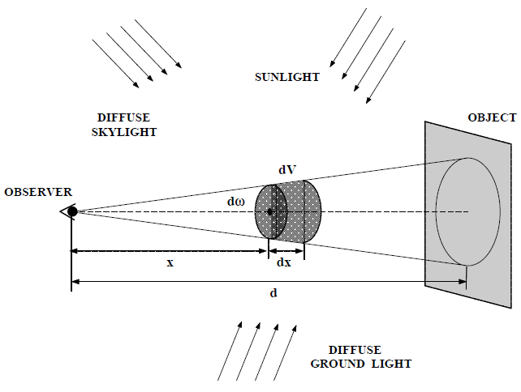
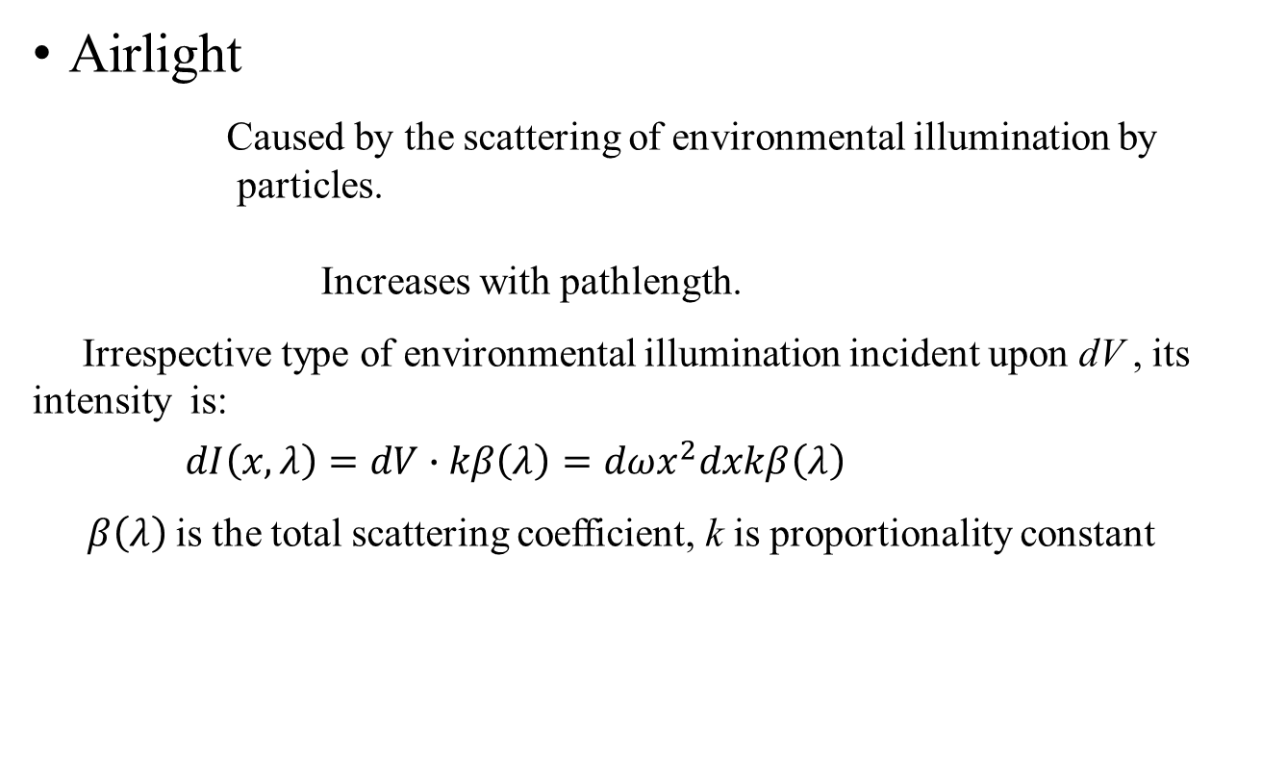
Quoted from Shree K. Nayar and Srinivasa G. Narasimhan “Vision in Bad Weather”
Airlight
Caused by the scattering of environmental illumination by particles.
Increases with pathlength.
Irrespective type of environmental illumination incident upon dV , its intensity is:
$dI\left(x,λ\right)=dV∙kβ\left(λ\right)=dωx^{2}dxkβ\left(λ\right)$
$β\left(λ\right)$ is the total scattering coefficient, k is proportionality constant
Reason
Characteristic

Slide 8
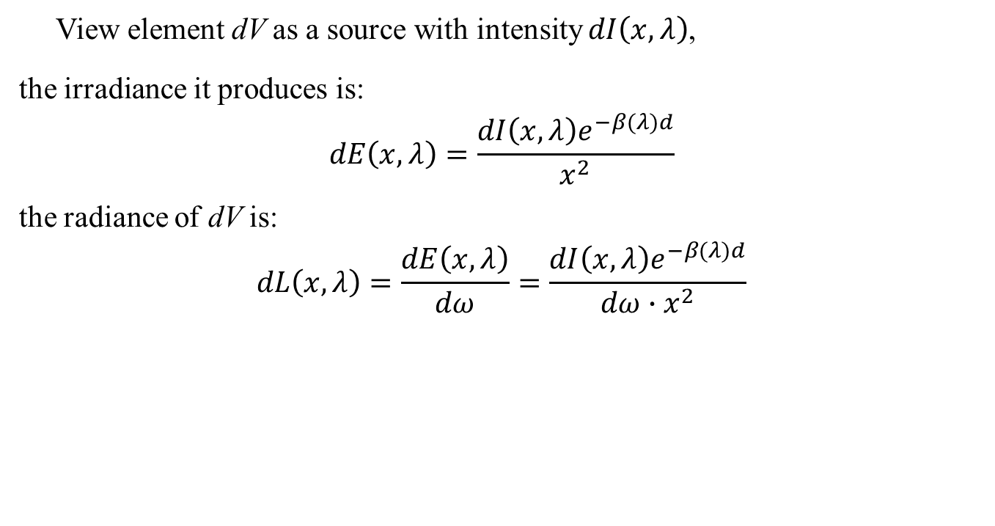
View element dV as a source with intensity $dI\left(x,λ\right)$,
the irradiance it produces is:
$$dE\left(x,λ\right)=\frac{dI\left(x,λ\right)e^{−β(λ)d}}{x^{2}}$$
the radiance of dV is:
$$dL\left(x,λ\right)=\frac{dE\left(x,λ\right)}{dω}=\frac{dI\left(x,λ\right)e^{−β(λ)d}}{dω{∙x}^{2}}$$

Slide 9
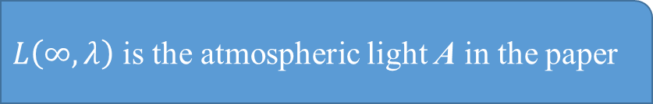
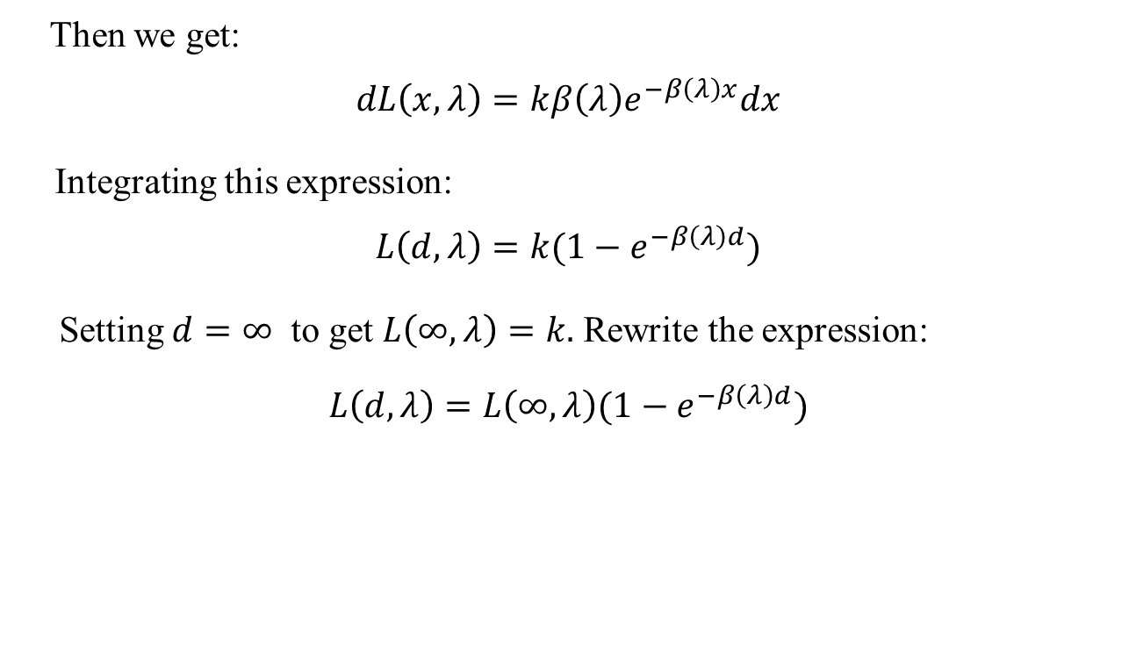
Then we get:
$$dL\left(x,λ\right)=k{β\left(λ\right)e}^{−β\left(λ\right)x}dx$$
Integrating this expression:
$$L\left(d,λ\right)=k{(1−e}^{−β\left(λ\right)d})$$
Setting $d=∞$ to get $L\left(∞,λ\right)=k.$ Rewrite the expression:
$$L\left(d,λ\right)=L\left(∞,λ\right){(1−e}^{−β\left(λ\right)d})$$
$L\left(∞,λ\right)$ is the atmospheric light A in the paper

Slide 10
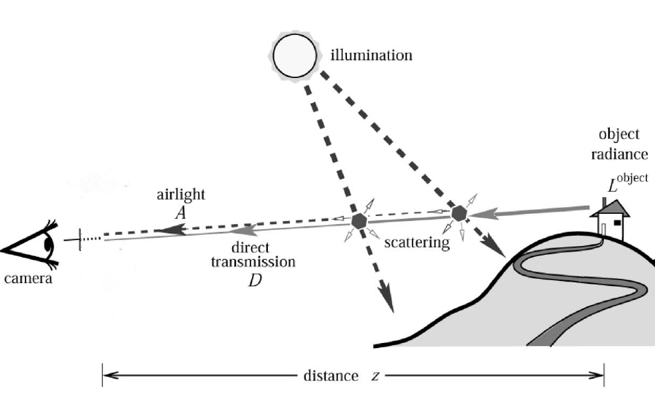
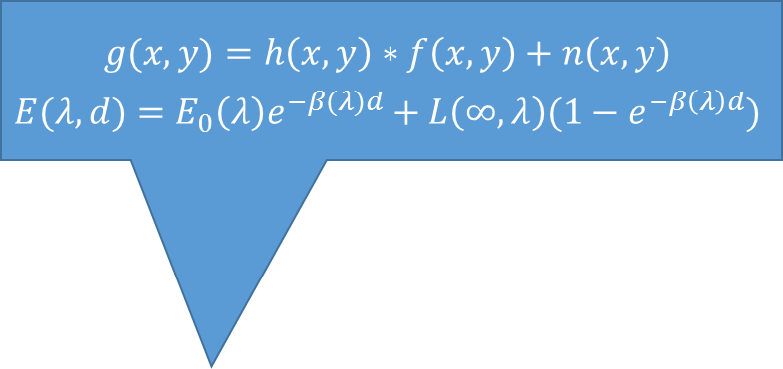
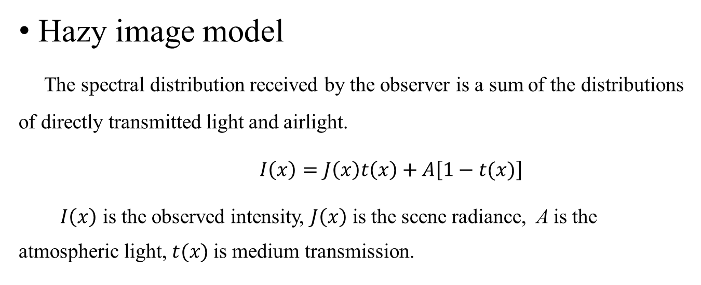
$$g(x,y)=h\left(x,y\right)∗f\left(x,y\right)+n\left(x,y\right)$$
$$E(λ,d)=E_{0}\left(λ\right)e^{−β(λ)d}+L\left(∞,λ\right){(1−e}^{−β\left(λ\right)d})$$
Hazy image model
The spectral distribution received by the observer is a sum of the distributions of directly transmitted light and airlight.
$I\left(x\right)=J\left(x\right)t\left(x\right)+A\left[1−t(x)\right]$
$I\left(x\right)$ is the observed intensity, $J\left(x\right)$ is the scene radiance, A is the atmospheric light, $t(x)$is medium transmission.
Picture quoted from Yoav Y. Schechner, Srinivasa G. Narasimhan, and Shree K. Nayar “Polarization-based vision through haze”

Slide 11
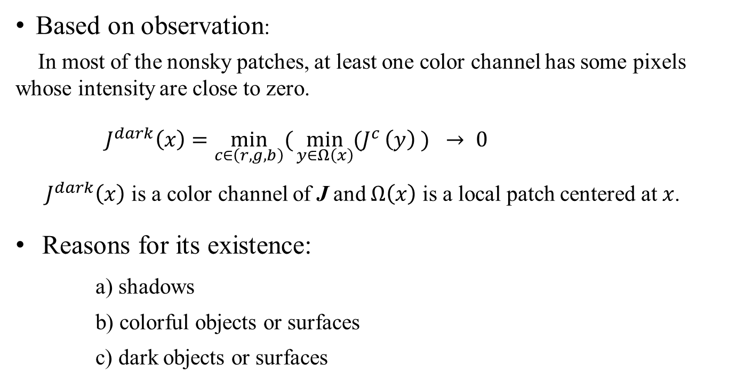
Dark channel pror
Based on observation:
In most of the nonsky patches, at least one color channel has some pixels whose intensity are close to zero.
${ J}^{dark}\left(x\right)=\min_{c∈\left(r,g,b\right)}({\min_{y∈Ω\left(x\right)}{{(J}^{c}}}\left(y\right) ) → 0$
${ J}^{dark}\left(x\right)$ is a color channel of J and $Ω\left(x\right)$ is a local patch centered at $x$.
Reasons for its existence:
a) shadows
b) colorful objects or surfaces
c) dark objects or surfaces

Slide 12
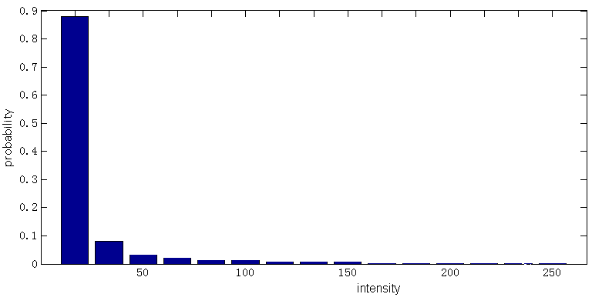
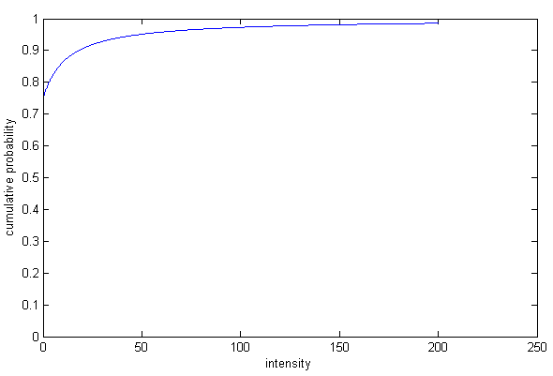
Notes: The dark channel prior is not a good prior for the sky regions.
Verify its correctness:
Select 5,000 images and manually cut out the sky regions. Their dark channels are computed using a patch size 15×15.
Statistical result:
Image size: 500x500, patch size: 15x15
75% dark channel values = 0
86% dark channel values < 16
90% dark channel values < 25

Slide 13
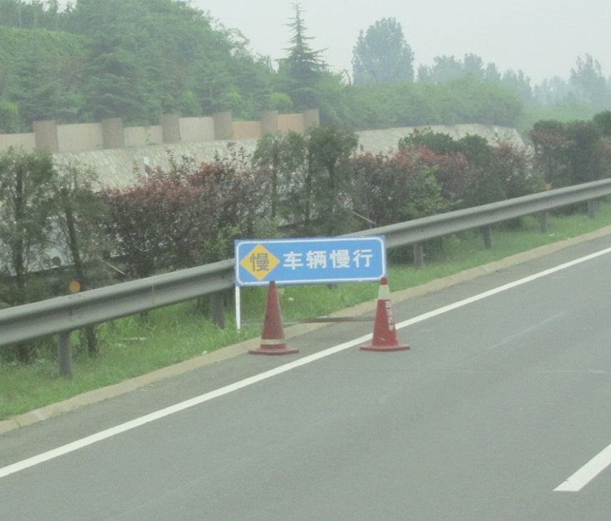
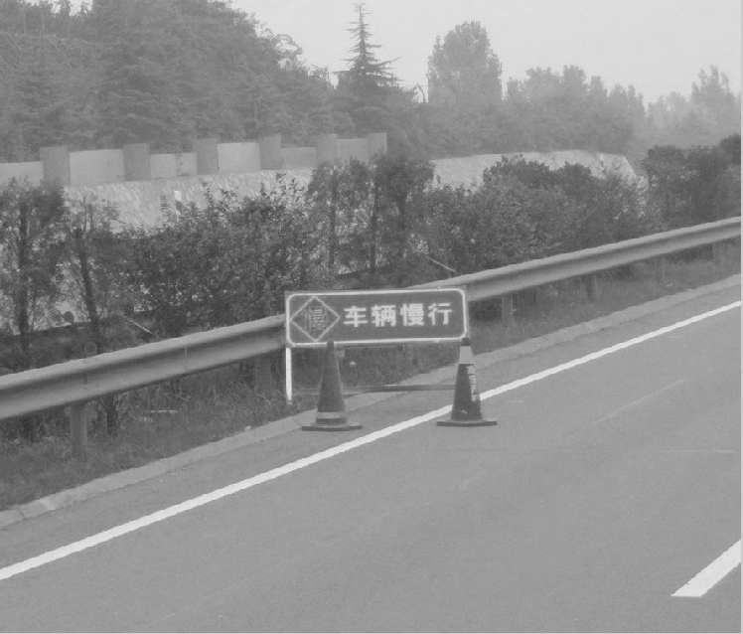
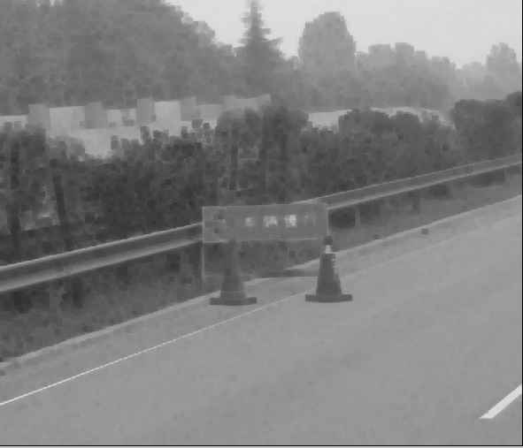
Original image
Min(R,G,B)
Dark channel

Slide 14
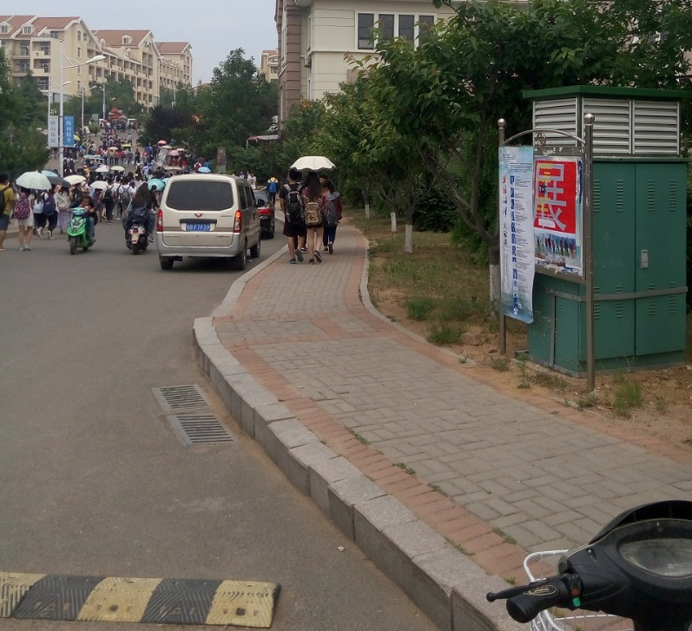
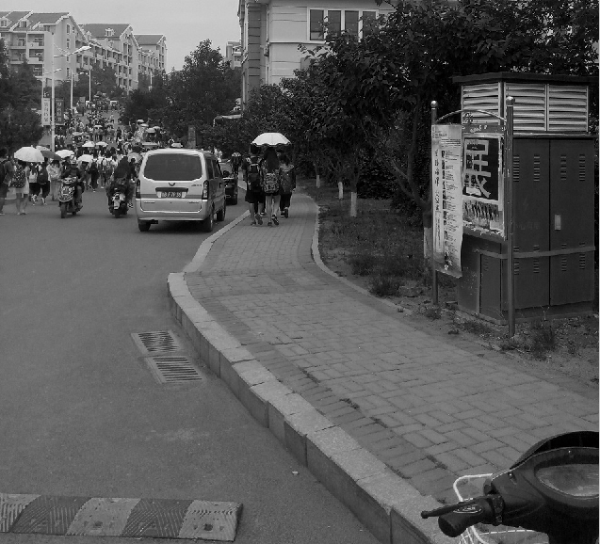
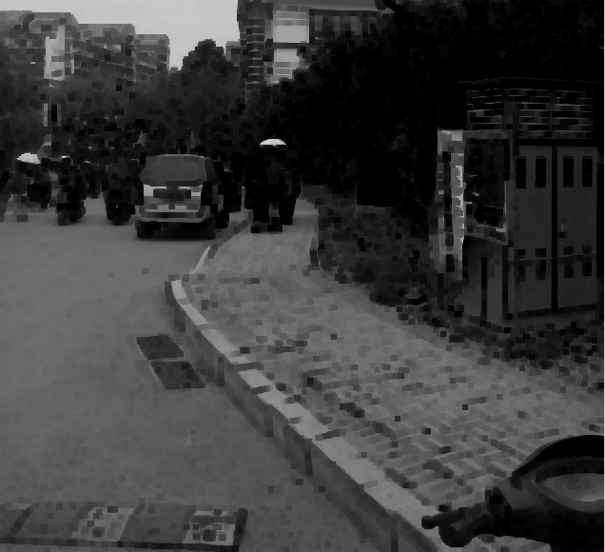
Original image
Min(R,G,B)
Dark channel

Slide 15
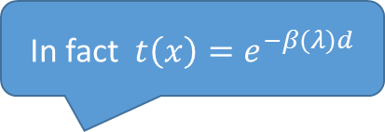
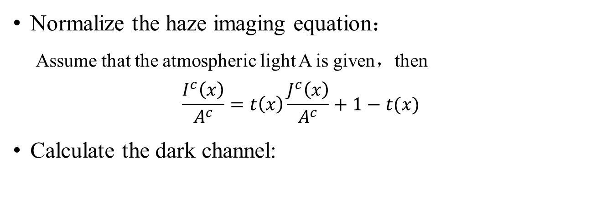
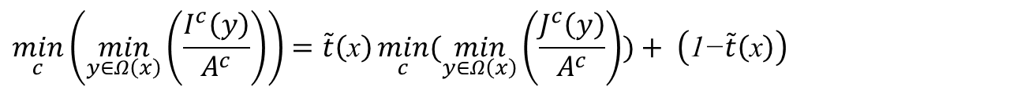
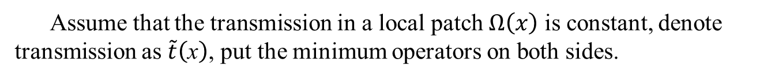
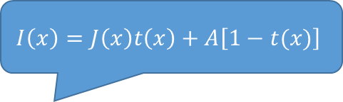
Estimating the Transmission
$$I\left(x\right)=J\left(x\right)t\left(x\right)+A\left[1−t(x)\right]$$
Normalize the haze imaging equation：
Assume that the atmospheric light A is given，then
$$\frac{I^{c}\left(x\right)}{A^{c}}=t\left(x\right)\frac{J^{c}\left(x\right)}{A^{c}}+1−t(x)$$
Calculate the dark channel:
In fact ${t\left(x\right)=e}^{−β(λ)d}$
Assume that the transmission in a local patch $Ω\left(x\right)$ is constant, denote transmission as $\tilde{t}\left(\text{x}\right)$, put the minimum operators on both sides.
$$\min_{c}\left(\min_{y∈Ω\left(x\right)}\left(\frac{I^{c}\left(y\right)}{A^{c}}\right)\right)=\tilde{t}\left(\text{x}\right)\min_{c}{(\min_{y∈Ω\left(x\right)}\left(\frac{J^{c}\left(y\right)}{A^{c}}\right)})+ \left(\text{1−}\tilde{t}\left(\text{x}\right)\right)$$
Use the minimum filter, its complexity is linear to the image size

Slide 16
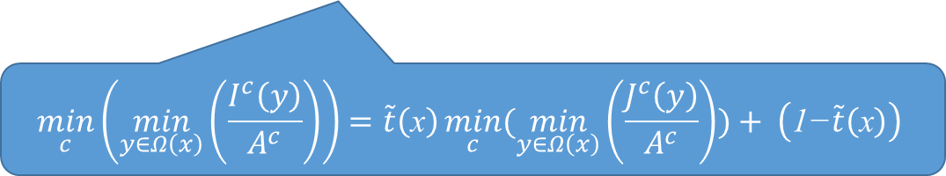
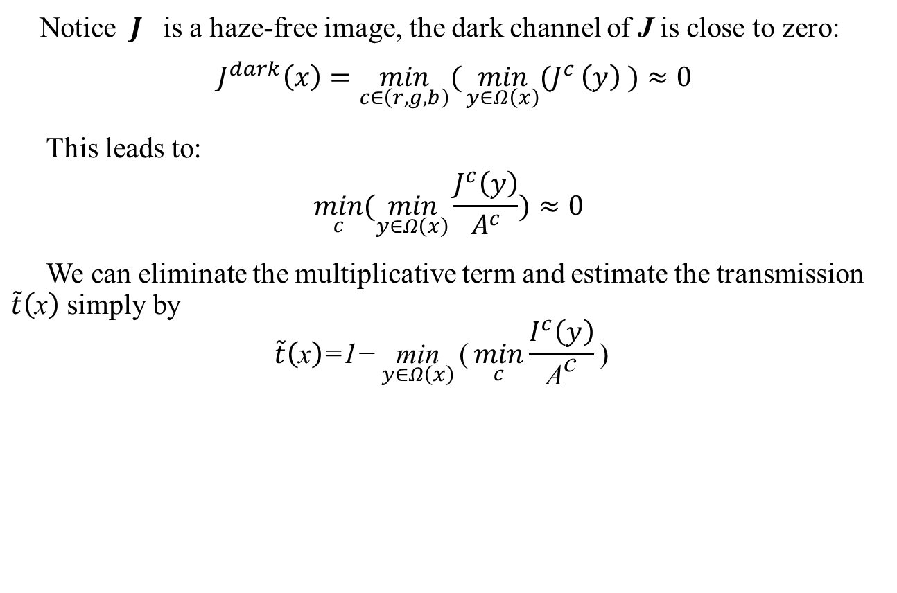
Notice $J^{}$is a haze-free image, the dark channel of J is close to zero:
$${ J}^{dark}\left(x\right)=\min_{c∈\left(r,g,b\right)}({\min_{y∈Ω\left(x\right)}{{(J}^{c}}}\left(y\right) )≈0$$
This leads to:
$$\min_{c}{(\min_{y∈Ω\left(x\right)}{\frac{J^{c}\left(y\right)}{A^{c}}}})≈0$$
We can eliminate the multiplicative term and estimate the transmission $\tilde{t}\left(\text{x}\right)$ simply by
$$\tilde{t}\left(\text{x}\right)\text{=1−}\underset{y∈Ω\left(x\right)}{\text{min}}{\text{(}\min_{c}{\frac{I^{c}\left(y\right)}{{\text{A}}^{\text{c}}}}\text{) }}$$
$$\min_{c}\left(\min_{y∈Ω\left(x\right)}\left(\frac{I^{c}\left(y\right)}{A^{c}}\right)\right)=\tilde{t}\left(\text{x}\right)\min_{c}{(\min_{y∈Ω\left(x\right)}\left(\frac{J^{c}\left(y\right)}{A^{c}}\right)})+ \left(\text{1−}\tilde{t}\left(\text{x}\right)\right)$$

Slide 17
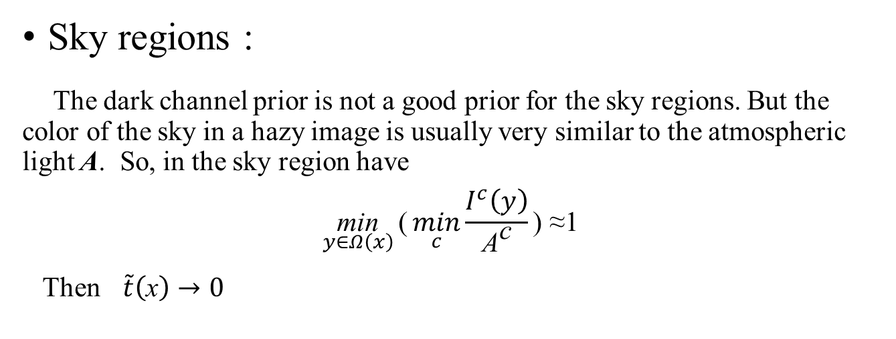
Sky regions :
The dark channel prior is not a good prior for the sky regions. But the color of the sky in a hazy image is usually very similar to the atmospheric light A. So, in the sky region have
$$\underset{y∈Ω\left(x\right)}{\text{min}}{\text{(}\min_{c}{\frac{I^{c}\left(y\right)}{{\text{A}}^{\text{c}}}}\text{) }\text{≈}\text{1} }$$
Then $\tilde{t}\left(\text{x}\right)→0$

Slide 18
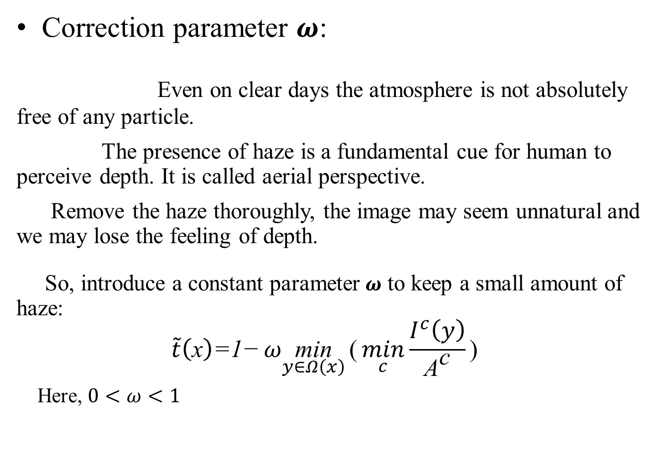
Correction parameter $ω$:
Even on clear days the atmosphere is not absolutely free of any particle.
The presence of haze is a fundamental cue for human to perceive depth. It is called aerial perspective.
Remove the haze thoroughly, the image may seem unnatural and we may lose the feeling of depth.
So, introduce a constant parameter$ω$ to keep a small amount of haze:
$$\tilde{t}\left(\text{x}\right)\text{=1−}ω\underset{y∈Ω\left(x\right)}{\text{min}}{\text{(}\min_{c}{\frac{I^{c}\left(y\right)}{{\text{A}}^{\text{c}}}}\text{) }}$$
Here, $0<ω<1$
Reason

Slide 19
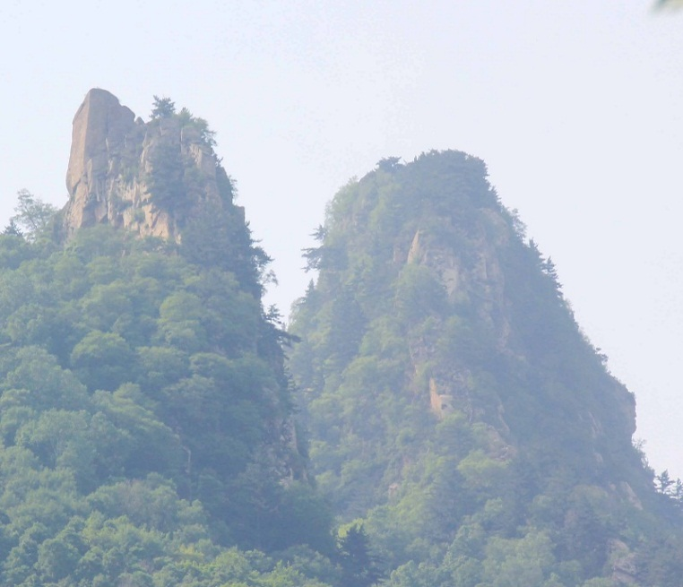
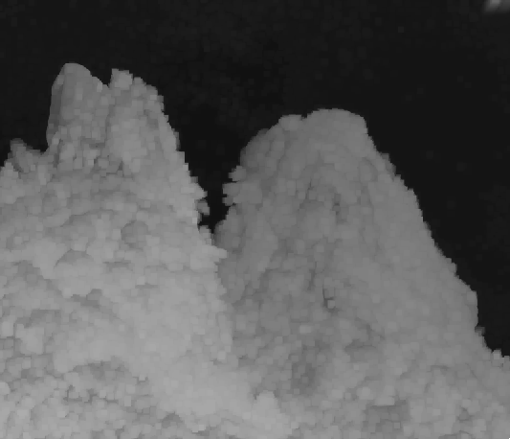
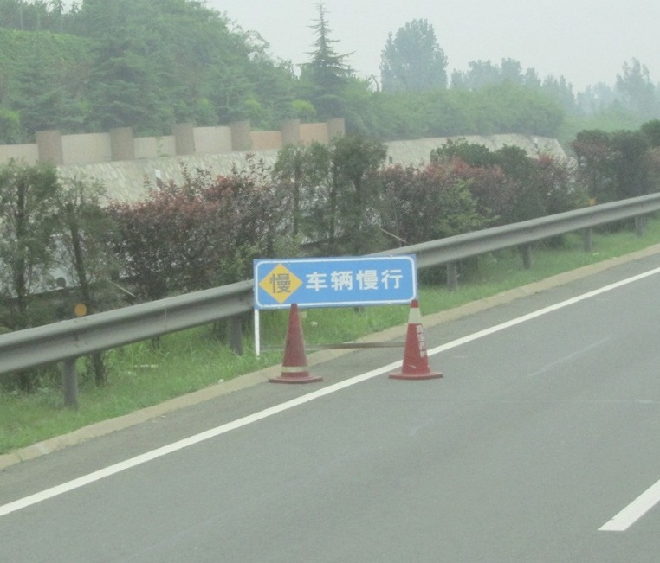
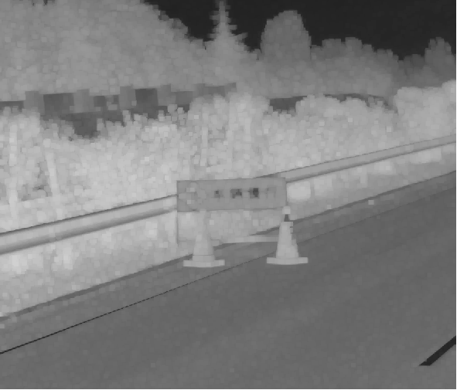
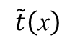
Original image
$$\tilde{t}\left(\text{x}\right)$$

Slide 20

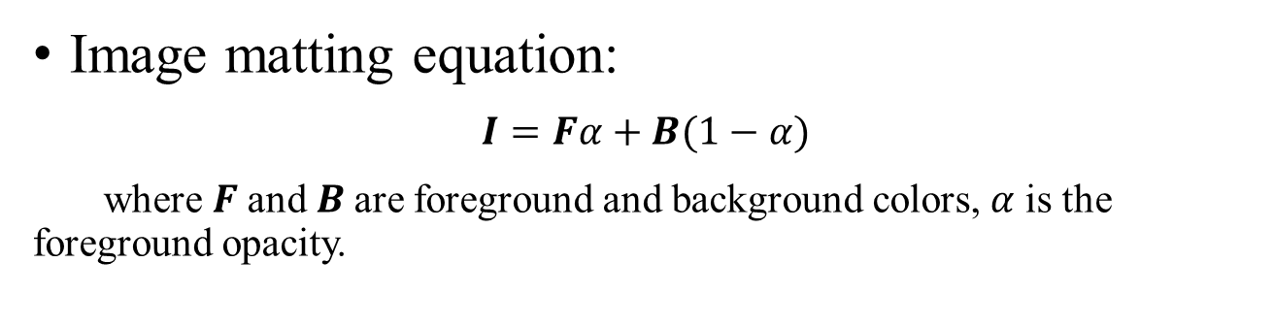
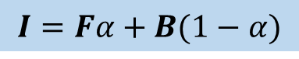
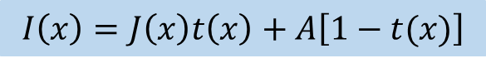
Soft matting: optimize $\tilde{t}\left(\text{x}\right)$
Image matting equation:
$$I=Fα+B(1−α)$$
where $F$and $B$are foreground and background colors,$α$ is the foreground opacity.
Compare with
$$I\left(x\right)=J\left(x\right)t\left(x\right)+A\left[1−t(x)\right]$$
$$I=Fα+B(1−α)$$

Slide 21


A closed-form framework of matting
Source
A.Levin, D. Lischinski, and Y. Weiss “A Closed Form Solution to Natural Image Matting”
Abstract
The author derive a cost function from local smoothness assumptions on foreground and background colors.
$α=argmin α^{T}Lα+λ{\left(α−b_{S}\right)}^{T}D_{s}\left(α−b_{S}\right)$
Solve a sparse linear system of equations to find the globally optimal$α$
$$\left(L+λD_{S}\right)α=λb_{S}$$
quoted from
where$λ$ is some large number, $D_{s}$ is a diagonal matrix whose diagonal elements are one for constrained pixels and zero for all other pixels, and $b_{S}$ is the vector containing the specified alpha values for the constrained pixels and zero for all other pixels.
Quoted from A.Levin, D. Lischinski, and Y. Weiss “A Closed Form Solution to Natural Image Matting”

Slide 22


Apply it to refine the transmission.
Denote the refined transmission map by $t(x)$. Rewriting $t(x)$ and $\tilde{t}\left(\text{x}\right)$in their vector forms as t and $\tilde{t}$,
$$E\left(t\right)=t^{T}Lt+λ{\left(t−\tilde{t}\right)}^{T} (t−\tilde{t})$$
where the matrix L is called the matting Laplacian matrix. Its (i , j) element is defined as
$$\sum_{k|(i,j)∈w_{k}}{\left\{δ_{ij}−\frac{1}{|w_{k}|}\left[1+{(I_{i}−μ_{k})}^{T}\right]{\left(\sum{k}+\frac{ε}{|w_{k}|}U_{3}\right)}^{−1}\left(I_{j}−μ_{k}\right)\right\}}$$
where $I_{i}$ and ${ I}_{j}$ are the colors of the input image I at pixels i and j,
$δ_{ij}$is the Kronecker delta, $μ_{k}$and $\sum{k }$are the mean and covariance matrix of the colors in window $w_{k}$, $U_{3}$ is a 3×3 identity matrix, $ε$ is a regularizing parameter, $|w_{k}|$ is the number of pixels in the window $w_{k}$.

Slide 23
Derivation of L
L is based on a color line assumption: The foreground / background colors in a small local patch lie on a single line in the RGB color space.
The color line assumption is valid in the problem of haze removal for the following reason：
First, the scene radiance J is a natural image, the color line model holds for natural images.
Second, the atmospheric light A is a constant, which satisfies the assumption.

Slide 24


The optimal t can be obtained by solving the following sparse linear system:
U is an identity matrix of the same size as L, $λ$ is a constant parameter (${10}^{−4}$ in the experiments).
$$\left(L+λU\right)t=λ\tilde{t}$$
This framework is mainly used to extrapolate the values into the unknown regions.
Notes

Slide 25

Bilateral filter:
After solving the linear system, then perform a bilateral filter on t to smooth its small scale textures.
The refined results show that the halos and block artifacts are suppressed.

Slide 26




Slide 27



Estimating the Atmospheric Light
Previous Work:
The brightest pixels in the hazy image are considered to be the most haze-opaque.
Ignore sunlight, scene radiance of each color channel is given by
$$J\left(x\right)=R\left(x\right)A$$
where $R\left(x\right)$is the reflectance of the scene points.
Rewrite the haze imaging equation as:
$$I\left(x\right)=R\left(x\right)At\left(x\right)+A\left[1−t(x)\right] ≤A$$
Tan’s work , “Visibility in Bad Weather from a Single Image”
$$t\left(x\right)≈0$$
$$⇒ A≈I\left(x\right)$$
𝐼(𝑥)=𝐽(𝑥)𝑡(𝑥)+𝐴[1−𝑡(𝑥)]

Slide 28


Drawback
In practice we can rarely ignore the sunlight. Considering the sunlight S, then
$$J\left(x\right)=R\left(x\right)(A+S)$$
×
$$I\left(x\right)=R\left(x\right)St\left(x\right)+R\left(x\right)At\left(x\right)+A≤A$$
$$⇒ A≈I\left(x\right)$$
×

Slide 29

Use the dark channel to detect the most haze-opaque region
Pick the top 0.1 percent brightest pixels in the dark channel.
Among these pixels, the pixels with highest intensity are selected as the atmospheric light.
$$A=I\left(x\right)$$
$I(x)$ is top 0.1 percent brightest pixels in the dark channel.
This method works well even when pixels at infinite distance do not exist in the image.
Notes

Slide 30

(a)
(b)
(a) Input image. (b) Dark channel and the most haze-opaque region. (c) The patch where is choose as atmospheric light. (d),(e) Two patches that contain pixels brighter than the atmospheric light.
Quoted from “Single Image Haze Removal
Using Dark Channel Prior”

Slide 31

When pixels at infinite distance do not exist in the image
(a)
(b)
(c)
(a) Input image. (b) Dark channel. The red pixels are the most haze-opaque regions detected the method. (c) Haze removal result.
Quoted from “Single Image Haze Removal
Using Dark Channel Prior”

Slide 32

Recovering the Scene Radiance
Restrict the transmission $t(x)$
Set a lower bound $t_{0}$. With the atmospheric light A and the transmission map $t\left(x\right)$, $J\left(x\right)$ recovered by
$$J\left(x\right)=\frac{I\left(x\right)−A}{max⁡(t\left(x\right),t_{0})}+A$$
Increase the exposure
The image after haze removal looks dim, so increase the exposure of $J\left(x\right)$ for display.
𝐼(𝑥)=𝐽(𝑥)𝑡(𝑥)+𝐴[1−𝑡(𝑥)]

Slide 33




Input image
Haze removal result
Input image
Haze removal result

Slide 34
Patch Size
The probability that a patch contains a dark pixel is increased.
patch size
The assumption that the transmission is constant in a patch becomes less appropriate

Slide 35


(a)
(b)
(c)
A haze-free image and its dark channels (b)using 3x3 and (c)using 15x15 patches
(a)
(b)
(c)
Hazy image and the recovered scene radiance using (b) 3x3 and (c)15x15 patches. The recovered scene radiance is oversaturated for a small patch size, while it contains apparent halos for a large patch size.
Quoted from “Single Image Haze Removal
Using Dark Channel Prior”

Slide 36

(a)
(b)
(c)
(d)
(a) Input hazy images. (b) Using 3x3 patches. (c) Using 15x15 patches. (d) Using 30x30 patches
Quoted from “Single Image Haze Removal
Using Dark Channel Prior”

Slide 37
Drawbacks
When scene objects are inherently similar to the atmospheric light.
When haze imaging model is physically invalid
Constant-airlight assumption may be unsuitable when the sunlight is very influential.
The transmission t is wavelength dependent if the particles in the atmosphere are small.

Slide 38

Thank you!

Slide 39
PPT结构图
计算暗通道
流程图
应用先验
设置阈值
退化函数
估算透射率
目录
光的散射衰减
天空区域
复原图像
成像模型
增强曝光
环境光的干扰
调节参数
成像模型
抠图方程
分块尺寸的影响
观察发现
优化透射率
封闭式结构抠图
用于优化透射率
存在的缺陷
暗原色先验
产生原因
忽略太阳光
验证
估算大气光
用暗通道

Slide 40
感谢何恺明、孙剑、汤晓鸥三位大师的这篇论文，让我从中学到了不少东西，另外非常感谢我的老师郑海永的悉心指导。 PPT的大部分内容用的也是这篇论文的原文，少部分引用了其他几篇论文，其中一部分雾图是从网上下载的。

